Slide 1
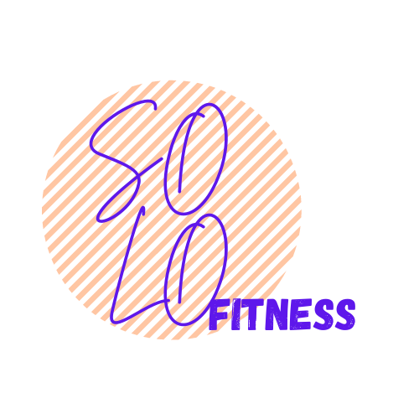
Ingenious-HACKATHON
2022
SHAIL PATEL - AU1940142
JAP PUROHIT - AU1940109
POOJAN SHETH - AU1940282
SAHIL MISKEEN - AU1940267
RAJ GARIWALA - AU1940118

Slide 2
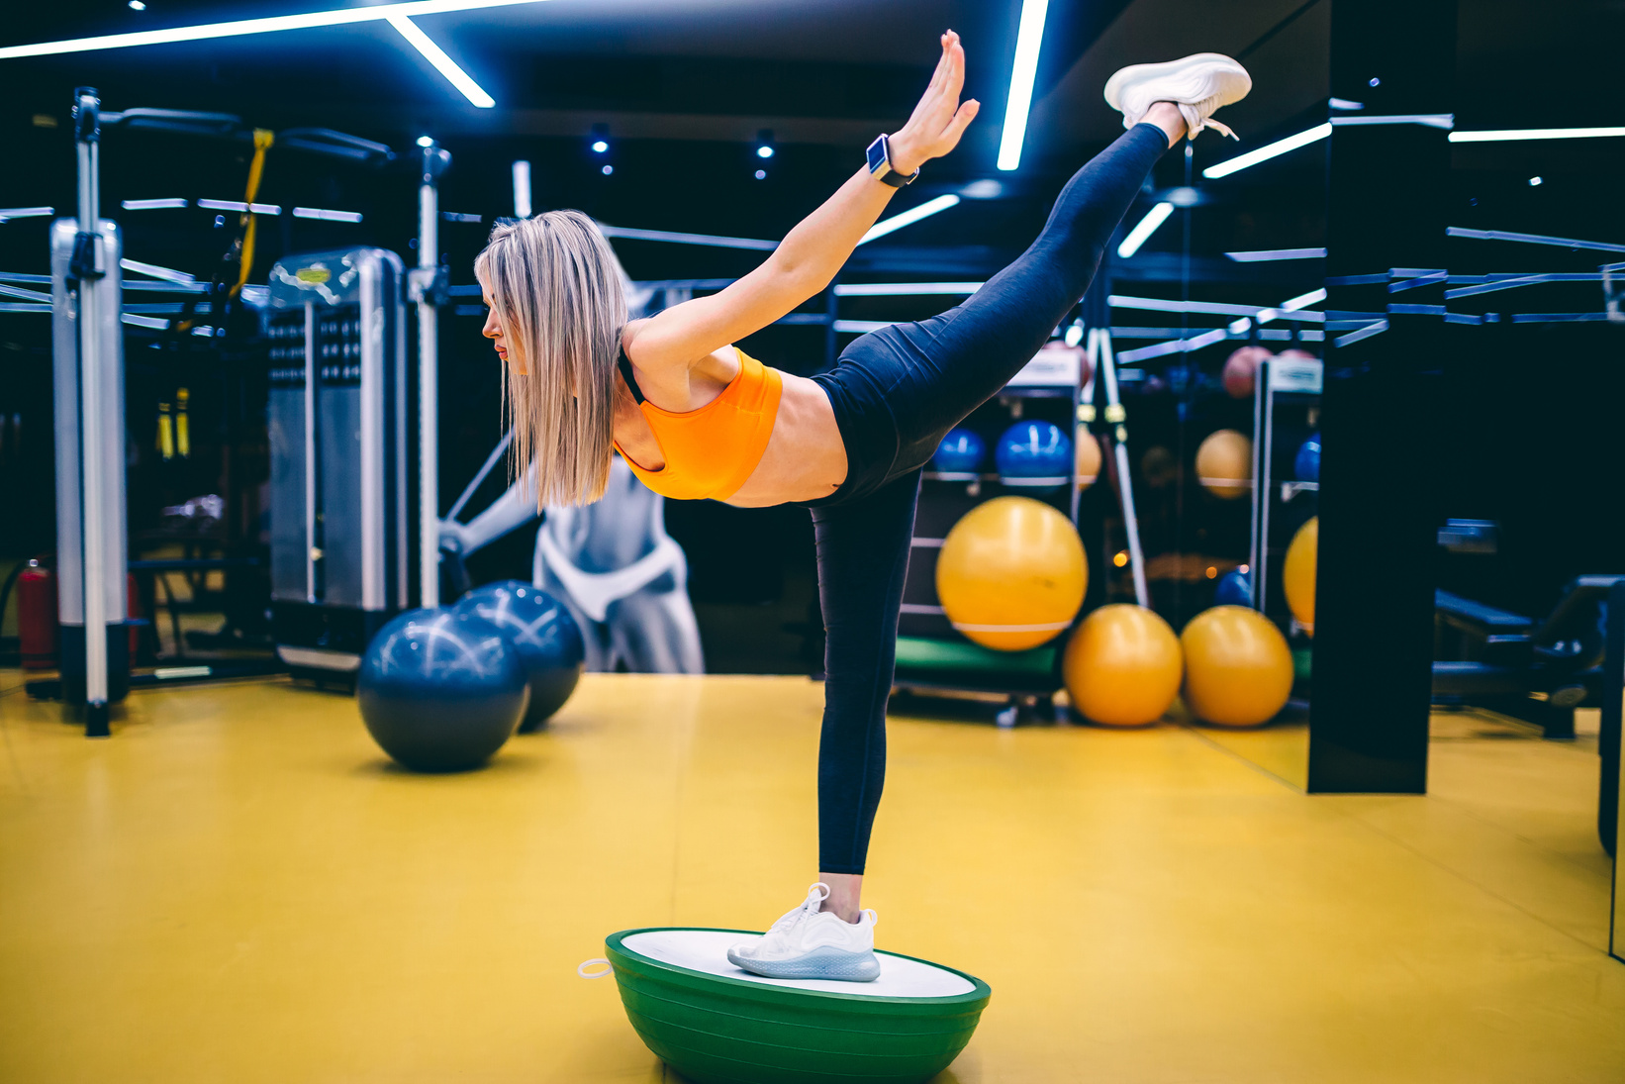
What is
SOLO Fitness?
How many times has it happened that you have had to go to the gym and you looked around for a trainer because you've had no idea about the exercise but are determined to do so? Well that happens to me a lot....... Not anymore!
Go solo with solo fitness - Your very own personal trainer.
And the best part? He'll always be with you

Slide 3
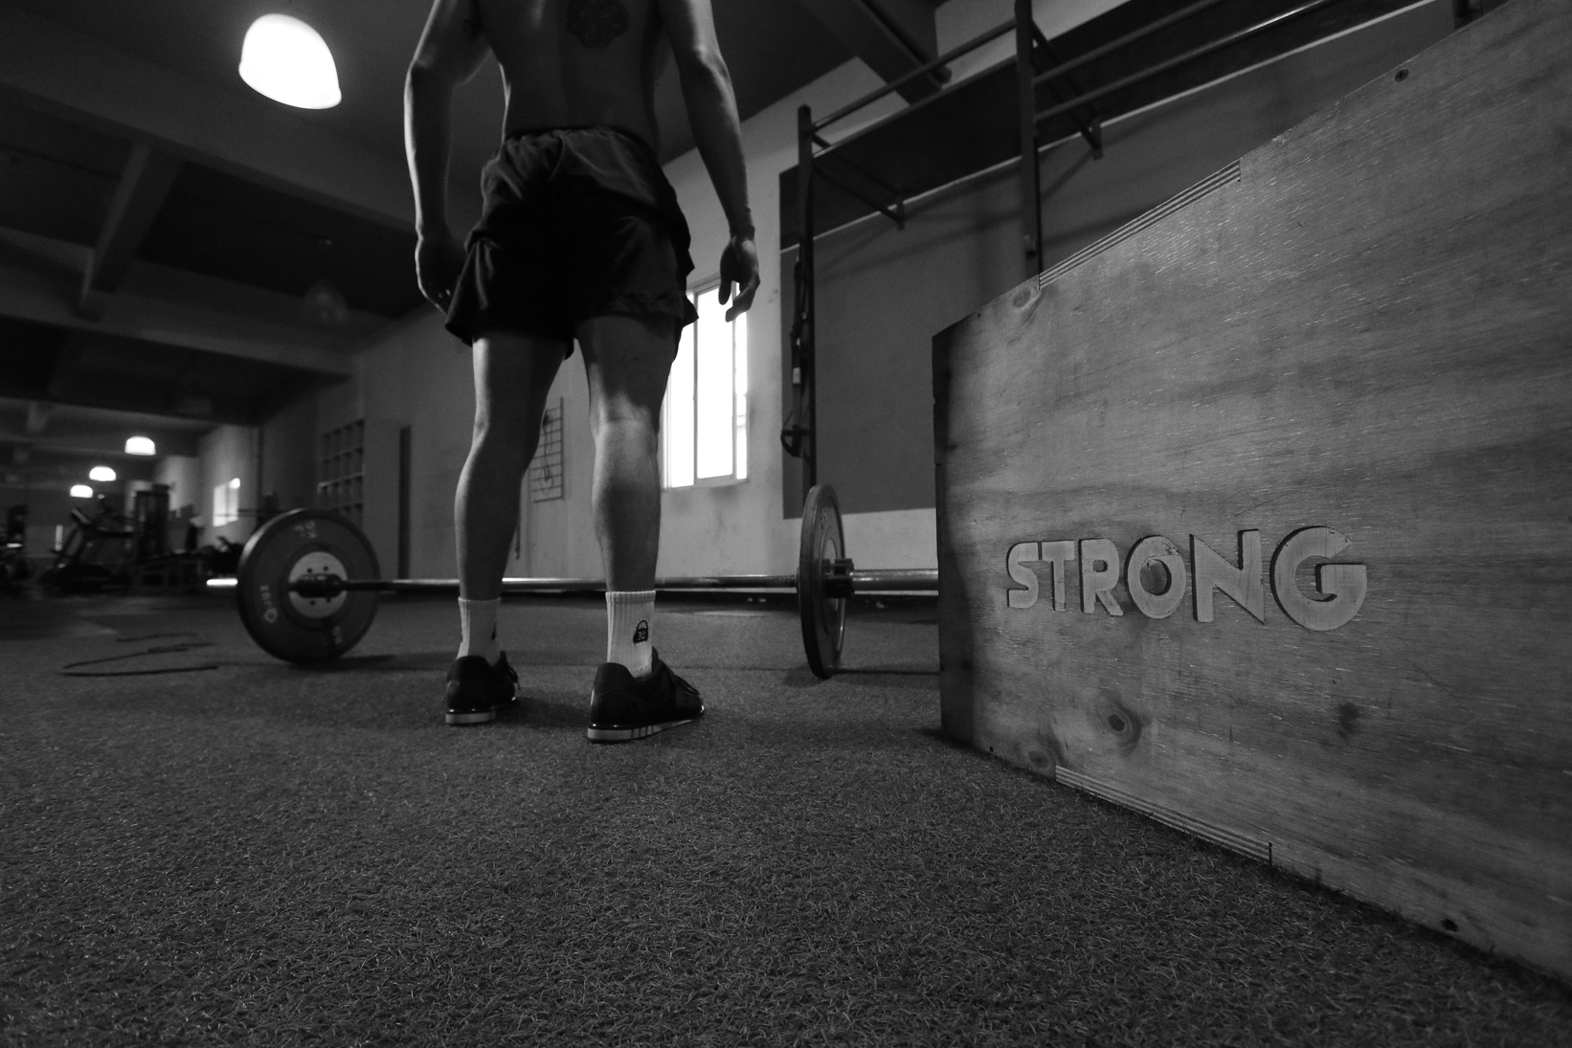
What do we do?
We aim to achieve an independent gym where in the users are able to have an personalized experience with the feel of a personal trainer. Providing with services such as posture detection and correction, experts-taught pre-recorded sessions and much more. Even if a user is not able to go to the gym he/she can download or use our website to get a proper gym experience with a trainer. The physiotherapist would be able to pinpoint the injury and make decision effectively and in a considerable fast manner than that of before.

Slide 4
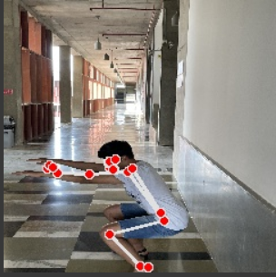
Our Journey
First approach
Our starting point needed us to make a dataset of correct and incorrect poses of exercises. We used our phone to create a dataset for the sit-up exercise. We then trained the model to see whether or not the final posture of the user was correct or wrong. We were successful in achieving the results.
1
Correct posture,
0 depicts incorrect

Slide 5
Our Journey
Drawback in the previous approach
Its not the final posture we wanted to check but rather the process that is leading you to that posture. For this we needed to make the process more dynamic which allowed us to compare frame by frame of the video showing the correct posture and the video of the exercise we are doing. The reason we did this is because even if we are able to achieve the final correct posture the process may not be right and with the previous model we didn't have a way of detecting that. Thus we worked upon frame detections based on that. Doing that we compared the score of the individual frames of both videos which gives us an indication whether or not the user is following the process correctly or not.

Slide 6
Our Journey
Drawback in the previous approach
We were able to successfully replicate the process of comparing videos frame by frame and giving the final output as a series of scores for different video frames. The average of all the scores was also taken in order to depict the user with what average accuracy is the user doing the exercise. A major problem with this work is the preprocessing if the data. The video needs to be short and clipped so as to only focus during the exercise part otherwise the output data would be too noisy to make decisions from. We will be working on this problem statement in the future so as to give an effective metric system to the user.

Slide 7
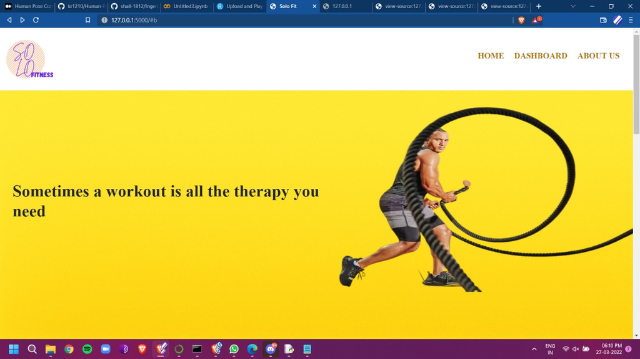
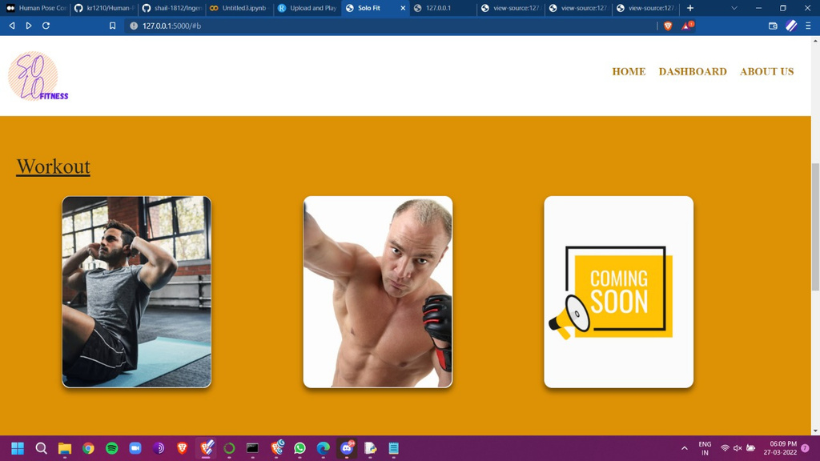
Task Flow
You land on the homepage. 2. Browse exercises next.

Slide 8
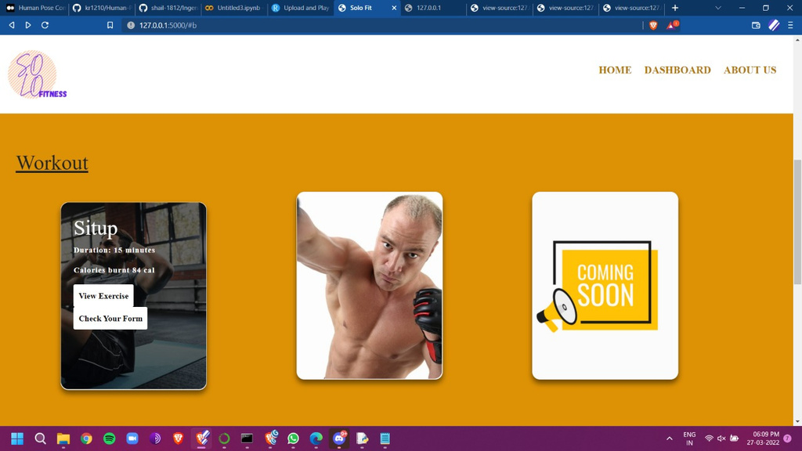
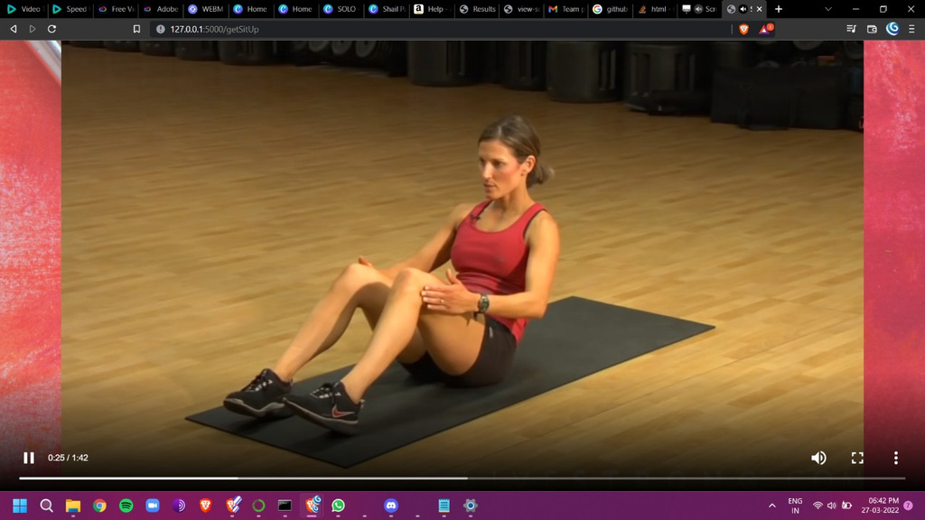
Task Flow
3. You can check the details of the exercise and select if you want to see the tutorial or check your accuracy.
4. Here you can view the tutorial of the desired exercise.

Slide 9
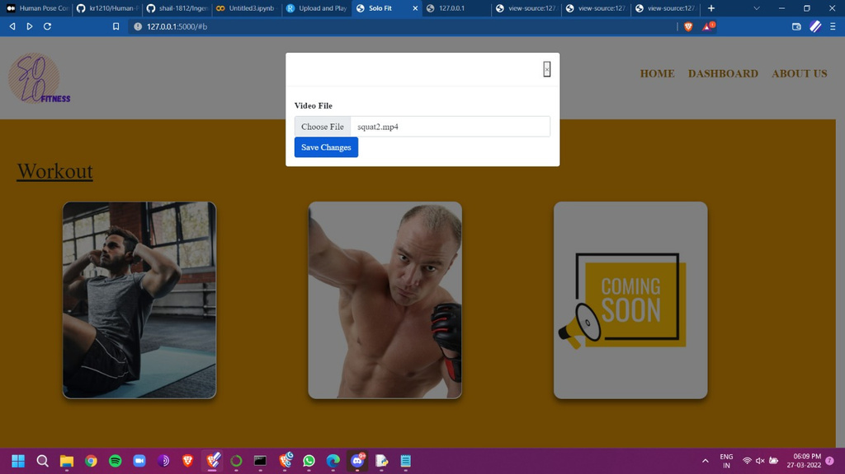
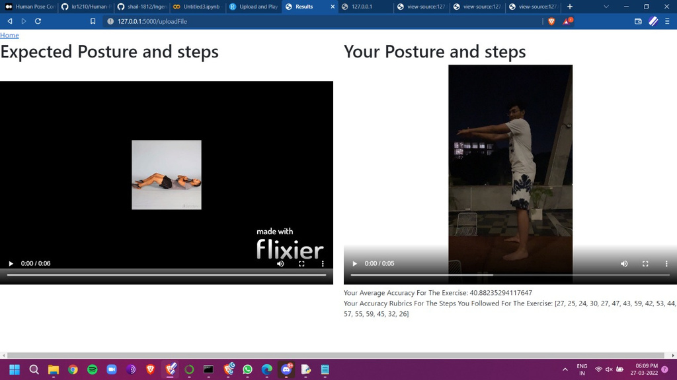
Task Flow
5. Upload the video you want to check accuracy for.
6. Here you can have side by side reference of the correct video and your accuracy rubrics.

Slide 10
Target Audience
Gyms, Health-Enthusiasts, Athletes, Physiotherapists
Gyms will be provided with a free trial for a year and then a fixed plan for 3 years which would allow the gyms to add as many users as needed by them.
Physio-therapists would have access to the routine of the the user in order to pinpoint the exercise which might have had caused the injury as well as monitor and have online sessions too and get real-time as well as pre-recorded data. This would allow the therapist to focus on a particular course of treatment.
Athletes often prefer to have a home gym. Well a personal trainer for the gym would be pretty cool. Right?
Health enthusiasts are often looking for exercises to maintain a good physical condition and this service can help in providing that.

Slide 11
Future Plans
To provide with the following
Live streaming of the exercise with visual and audio cues to provide information to the user where he/she is going wrong (head/shoulder/leg/arms etc.).
Data Trend Retention
The past routine of the user can be used by the user to have an idea where the user is going wrong and can be used to improve the score of the exercise he/she is performing to get the score as close as possible to the correct exercise video.
The past trend can be used for users who suffer an injury following the routine. This can be very helpful for serious athletes who spend a considerable amount of time in gym. If they suffer from injury while working out the data can be used to pinpoint the exercise which might have led to the injury.

